Slide 1
Software Life Cycle & different Models

Slide 2
Software Life Cycle
Software life cycle (or software process):
Series of identifiable stages that a software product undergoes during its life time:
Feasibility study
Requirements analysis and specification,
Design,
Coding,
Testing
maintenance.

Slide 3
Life Cycle Model
A software life cycle model (or process model):
a descriptive and diagrammatic model of software life cycle:
identifies all the activities required for product development,
establishes a precedence ordering among the different activities,
Divides life cycle into phases.

Slide 4
Life Cycle Model (CONT.)
Several different activities may be carried out in each life cycle phase.
For example, the design stage might consist of:
structured analysis activity followed by
structured design activity.

Slide 5
Why Model Life Cycle ?
A written description:
Forms a common understanding of activities among the software developers.
Helps in identifying inconsistencies, redundancies, and omissions in the development process.
Helps in tailoring a process model for specific projects.

Slide 6
Why Model Life Cycle ?
Processes are tailored for special projects.
A documented process model
Helps to identify where the tailoring is to occur.

Slide 7
Life Cycle Model (CONT.)
The development team must identify a suitable life cycle model:
and then adhere to it.
Primary advantage of adhering to a life cycle model:
Helps development of software in a systematic and disciplined manner.

Slide 8
Life Cycle Model (CONT.)
When a program is developed by a single programmer ---
he has the freedom to decide his exact steps.

Slide 9
Life Cycle Model (CONT.)
When a software product is being developed by a team:
there must be a precise understanding among team members as to when to do what,
otherwise it would lead to chaos and project failure.

Slide 10
Life Cycle Model (CONT.)
A software project will never succeed if:
one engineer starts writing code,
another concentrates on writing the test document first,
yet another engineer first defines the file structure
another defines the I/O for his portion first.

Slide 11
Life Cycle Model (CONT.)
A life cycle model:
defines entry and exit criteria for every phase.
A phase is considered to be complete:
only when all its exit criteria are satisfied.

Slide 12
Life Cycle Model (CONT.)
The phase exit criteria for the software requirements specification phase:
Software Requirements Specification (SRS) document is complete, reviewed, and approved by the customer.
A phase can start:
only if its phase-entry criteria have been satisfied.

Slide 13
Life Cycle Model (CONT.)
It becomes easier for software project managers:
to monitor the progress of the project.

Slide 14
Life Cycle Model (CONT.)
When a life cycle model is adhered to,
the project manager can at any time fairly accurately tell,
at which stage (e.g., design, code, test, etc. ) of the project is.
Otherwise, it becomes very difficult to track the progress of the project
the project manager would have to depend on the guesses of the team members.

Slide 15
Life Cycle Model (CONT.)
This usually leads to a problem:
known as the 99% complete syndrome.

Slide 16
Life Cycle Model (CONT.)
Many life cycle models have been proposed.
We will confine our attention to a few important and commonly used models.
Classical waterfall model
Iterative waterfall,
Evolutionary,
Prototyping,
Spiral model, and
RAD model

Slide 17
Classical Waterfall Model
Classical waterfall model divides life cycle into phases:
feasibility study,
requirements analysis and specification,
design,
coding and unit testing,
integration and system testing,
maintenance.

Slide 18
Classical Waterfall Model
Feasibility Study
Req. Analysis
Design
Coding
Testing
Maintenance

Slide 19
Relative Effort for Phases
Phases between feasibility study and testing
known as development phases.
Among all life cycle phases
maintenance phase consumes maximum effort.
Among development phases,
testing phase consumes the maximum effort.
Relative Effort

Slide 20
Classical Waterfall Model (CONT.)
Most organizations usually define:
standards on the outputs (deliverables) produced at the end of every phase
entry and exit criteria for every phase.
They also prescribe specific methodologies for:
specification,
design,
testing,
project management, etc.

Slide 21
Classical Waterfall Model (CONT.)
The guidelines and methodologies of an organization:
called the organization's software development methodology.
Software development organizations:
expect fresh engineers to master the organization's software development methodology.

Slide 22
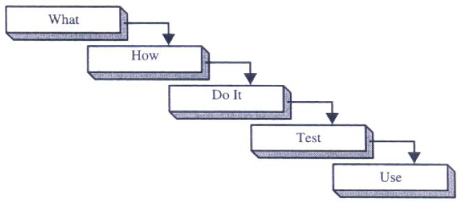
Classical Waterfall Model

Slide 23
Feasibility Study
Main aim of feasibility study:determine whether developing the product
financially worthwhile
technically feasible.
First roughly understand what the customer wants:
different data which would be input to the system,
processing needed on these data,
output data to be produced by the system,
various constraints on the behavior of the system.

Slide 24
Activities during Feasibility Study
Work out an overall understanding of the problem.
Formulate different solution strategies.
Examine alternate solution strategies in terms of:
resources required,
cost of development, and
development time.

Slide 25
Activities during Feasibility Study
Perform a cost/benefit analysis:
to determine which solution is the best.
you may determine that none of the solutions is feasible due to:
high cost,
resource constraints,
technical reasons.

Slide 26
Requirements Analysis and Specification
Aim of this phase:
understand the exact requirements of the customer,
document them properly.
Consists of two distinct activities:
requirements gathering and analysis
requirements specification.

Slide 27
Goals of Requirements Analysis
Collect all related data from the customer:
analyze the collected data to clearly understand what the customer wants,
find out any inconsistencies and incompleteness in the requirements,
resolve all inconsistencies and incompleteness.

Slide 28
Requirements Gathering
Gathering relevant data:
usually collected from the end-users through interviews and discussions.
For example, for a business accounting software:
interview all the accountants of the organization to find out their requirements.

Slide 29
Requirements Analysis (CONT.)
The data you initially collect from the users:
would usually contain several contradictions and ambiguities:
each user typically has only a partial and incomplete view of the system.

Slide 30
Requirements Analysis (CONT.)
Ambiguities and contradictions:
must be identified
resolved by discussions with the customers.
Next, requirements are organized:
into a Software Requirements Specification (SRS) document.

Slide 31
Requirements Analysis (CONT.)
Engineers doing requirements analysis and specification:
are designated as analysts.

Slide 32
Design
Design phase transforms requirements specification:
into a form suitable for implementation in some programming language.

Slide 33
Design
In technical terms:
during design phase, software architecture is derived from the SRS document.
Two design approaches:
traditional approach,
object oriented approach.

Slide 34
Traditional Design Approach
Consists of two activities:
Structured analysis
Structured design

Slide 35
Structured Analysis Activity
Identify all the functions to be performed.
Identify data flow among the functions.
Decompose each function recursively into sub-functions.
Identify data flow among the subfunctions as well.

Slide 36
Structured Analysis (CONT.)
Carried out using Data flow diagrams (DFDs).
After structured analysis, carry out structured design:
architectural design (or high-level design)
detailed design (or low-level design).

Slide 37
Structured Design
High-level design:
decompose the system into modules,
represent invocation relationships among the modules.
Detailed design:
different modules designed in greater detail:
data structures and algorithms for each module are designed.

Slide 38
Object Oriented Design
First identify various objects (real world entities) occurring in the problem:
identify the relationships among the objects.
For example, the objects in a pay-roll software may be:
employees,
managers,
pay-roll register,
Departments, etc.

Slide 39
Object Oriented Design (CONT.)
Object structure
further refined to obtain the detailed design.
OOD has several advantages:
lower development effort,
lower development time,
better maintainability.

Slide 40
Implementation
Purpose of implementation phase (aka coding and unit testing phase):
translate software design into source code.

Slide 41
Implementation
During the implementation phase:
each module of the design is coded,
each module is unit tested
tested independently as a stand alone unit, and debugged,
each module is documented.

Slide 42
Implementation (CONT.)
The purpose of unit testing:
test if individual modules work correctly.
The end product of implementation phase:
a set of program modules that have been tested individually.

Slide 43
Integration and System Testing
Different modules are integrated in a planned manner:
modules are almost never integrated in one shot.
Normally integration is carried out through a number of steps.
During each integration step,
the partially integrated system is tested.

Slide 44
Integration and System Testing
M1
M2
M3
M4

Slide 45
System Testing
After all the modules have been successfully integrated and tested:
system testing is carried out.
Goal of system testing:
ensure that the developed system functions according to its requirements as specified in the SRS document.

Slide 46
Maintenance
Maintenance of any software product:
requires much more effort than the effort to develop the product itself.
development effort to maintenance effort is typically 40:60.

Slide 47
Maintenance (CONT.)
Corrective maintenance:
Correct errors which were not discovered during the product development phases.
Perfective maintenance:
Improve implementation of the system
enhance functionalities of the system.
Adaptive maintenance:
Port software to a new environment,
e.g. to a new computer or to a new operating system.

Slide 48
Iterative Waterfall Model
Classical waterfall model is idealistic:
assumes that no defect is introduced during any development activity.
in practice:
defects do get introduced in almost every phase of the life cycle.

Slide 49
Iterative Waterfall Model (CONT.)
Defects usually get detected much later in the life cycle:
For example, a design defect might go unnoticed till the coding or testing phase.

Slide 50
Iterative Waterfall Model (CONT.)
Once a defect is detected:
we need to go back to the phase where it was introduced
redo some of the work done during that and all subsequent phases.
Therefore we need feedback paths in the classical waterfall model.

Slide 51
Iterative Waterfall Model (CONT.)
Feasibility Study
Req. Analysis
Design
Coding
Testing
Maintenance

Slide 52
Iterative Waterfall Model (CONT.)
Errors should be detected
in the same phase in which they are introduced.
For example:
if a design problem is detected in the design phase itself,
the problem can be taken care of much more easily
than say if it is identified at the end of the integration and system testing phase.

Slide 53
Phase containment of errors
Reason: rework must be carried out not only to the design but also to code and test phases.
The principle of detecting errors as close to its point of introduction as possible:
is known as phase containment of errors.
Iterative waterfall model is by far the most widely used model.
Almost every other model is derived from the waterfall model.

Slide 54
Classical Waterfall Model (CONT.)
Irrespective of the life cycle model actually followed:
the documents should reflect a classical waterfall model of development,
comprehension of the documents is facilitated.

Slide 55
Prototyping Model
Before starting actual development,
a working prototype of the system should first be built.
A prototype is a toy implementation of a system:
limited functional capabilities,
low reliability,
inefficient performance.

Slide 56
Reasons for developing a prototype
Illustrate to the customer:
input data formats, messages, reports, or interactive dialogs.
Examine technical issues associated with product development:
Often major design decisions depend on issues like:
response time of a hardware controller,
efficiency of a sorting algorithm, etc.

Slide 57
Prototyping Model (CONT.)
The third reason for developing a prototype is:
it is impossible to “get it right” the first time,
we must plan to throw away the first product
if we want to develop a good product.

Slide 58
Prototyping Model (CONT.)
Start with approximate requirements.
Carry out a quick design.
Prototype model is built using several short-cuts:
Short-cuts might involve using inefficient, inaccurate, or dummy functions.
A function may use a table look-up rather than performing the actual computations.

Slide 59
Prototyping Model (CONT.)
The developed prototype is submitted to the customer for his evaluation:
Based on the user feedback, requirements are refined.
This cycle continues until the user approves the prototype.
The actual system is developed using the classical waterfall approach.

Slide 60
Prototyping Model (CONT.)
Build Prototype
Requirements
Gathering
Customer Evaluation of Prototype
Customer
Quick Design
Design
satisfied
Implement
Refine Requirements
Test
Maintain

Slide 61
Prototyping Model (CONT.)
Requirements analysis and specification phase becomes redundant:
final working prototype (with all user feedbacks incorporated) serves as an animated requirements specification.
Design and code for the prototype is usually thrown away:
However, the experience gathered from developing the prototype helps a great deal while developing the actual product.

Slide 62
Prototyping Model (CONT.)
Even though construction of a working prototype model involves additional cost --- overall development cost might be lower for:
systems with unclear user requirements,
systems with unresolved technical issues.
Many user requirements get properly defined and technical issues get resolved:
these would have appeared later as change requests and resulted in incurring massive redesign costs.

Slide 63
Evolutionary Model
Evolutionary model (successive versions or incremental model):
The system is broken down into several modules which can be incrementally implemented and delivered.
First develop the core modules of the system.
The initial product skeleton is refined into increasing levels of capability:
by adding new functionalities in successive versions.

Slide 64
Evolutionary Model (CONT.)
Successive version of the product:
functioning systems capable of performing some useful work.
A new release may include new functionality:
also existing functionality in the current release might have been enhanced.

Slide 65
Evolutionary Model (CONT.)
C
A
A
A
B
B

Slide 66
Advantages of Evolutionary Model
Users get a chance to experiment with a partially developed system:
much before the full working version is released,
Helps finding exact user requirements:
much before fully working system is developed.
Core modules get tested thoroughly:
reduces chances of errors in final product.

Slide 67
Disadvantages of Evolutionary Model
Often, difficult to subdivide problems into functional units:
which can be incrementally implemented and delivered.
evolutionary model is useful for very large problems,
where it is easier to find modules for incremental implementation.

Slide 68
Evolutionary Model with Iteration
Many organizations use a combination of iterative and incremental development:
a new release may include new functionality
existing functionality from the current release may also have been modified.

Slide 69
Evolutionary Model with iteration
Several advantages:
Training can start on an earlier release
customer feedback taken into account
Markets can be created:
for functionality that has never been offered.
Frequent releases allow developers to fix unanticipated problems quickly.

Slide 70
Spiral Model
Proposed by Boehm in 1988.
It is a combination of Iterative development process and sequential liner development model (i.e water fall) with high emphasis on risk analysia.

Slide 71
Spiral Model (cont.)
Each loop of the spiral represents a phase of the software process:
the innermost loop might be concerned with system feasibility,
the next loop with system requirements definition,
the next one with system design, and so on.
There are no fixed phases in this model, the phases shown in the figure are just examples.
It has FOUR phases and repeatedly passes throgh these phases in iterations called SPIRAL.
Identification
Design
Construct/Build
Risk Management

Slide 73
Spiral Model (CONT.)
The team must decide:
how to structure the project into phases.
Start work using some generic model:
add extra phases
for specific projects or when problems are identified during a project.
Each loop in the spiral is split into four sectors (quadrants).

Slide 74
Spiral Model (CONT.)
Determine Objectives
Identify & Resolve Risks
Customer Evaluation of Prototype
Develop Next Level of Product

Slide 75
Basic concepts of Spiral Development

Slide 76
Spiral Model (CONT.)
Process is represented as a spiral rather than as a sequence of activities with backtracking.
Each loop = One Iteration = A process phase.
Each Loop passes through 4 quadrants (90°):
Objective Setting.
Risk Assessment and Reduction.
Development and Validation.
Planning.
As loops move away from center → Time and Cost increase.

Slide 77
Objective Setting (First Quadrant)
Identify objectives of the phase,
Requirements are gathered during the planning phase. Requirements like ‘BRS’ that is ‘Bussiness Requirement Specifications’ and ‘SRS’ that is ‘System Requirement specifications’.
Examine the risks associated with these objectives.
Find alternate solutions possible.

Slide 78
Risk Assessment and Reduction (Second Quadrant)
For each identified project risk,
In the risk analysis phase, a process is undertaken to identify risk and alternate solutions.
A prototype is produced at the end of the risk analysis phase.
If any risk is found during the risk analysis then alternate solutions are suggested and implemented.
Steps are taken to reduce the risk.

Slide 79
Spiral Model (CONT.)
Development and Validation (Third quadrant):
In this phase software is developed, along with testing at the end of the phase. Hence in this phase the development and testing is done.
develop and validate the next level of the product.

Slide 80
Spiral Model (CONT.)
Review and Planning (Fourth quadrant):
review the results achieved so far with the customer and plan the next iteration around the spiral.
With each iteration around the spiral:
progressively more complete version of the software gets built.

Slide 82
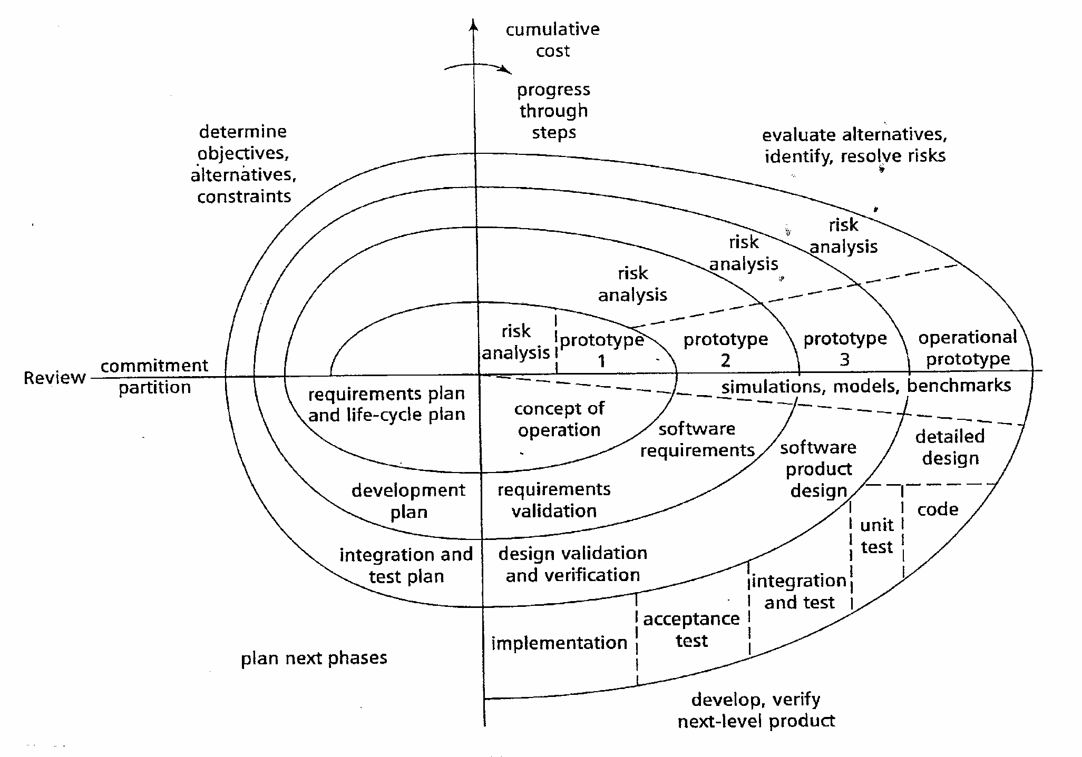
Diagram of Boehm’s Spiral Model

Slide 83
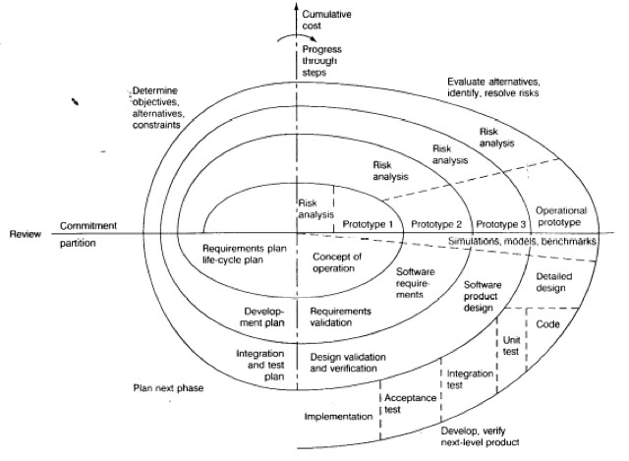
Round 1, Concept of Operations, Quadrant IV: Determine Objectives,Alternatives & Constraints
Project
Start
Notes:
During the first phase (upper left quadrant), developers explore alternatives, define constraints, and identify objectives.

Slide 84
Round 1, Concept of Operations, Quadrant I: Evaluate Alternatives, identify & resolve Risks
Risk Analysis
Notes:
During the second phase (upper right quadrant), developers manage risks associated with the solutions defined during the first phase and specify a prototype to be built in the next phase

Slide 85
Round 1, Concept of Operations, Quadrant II: Develop and Verify
Concept of Operation
Activity
Notes:
During the third phase (lower right quadrant), developers realize and validate a prototype or the part of the system associated with the risks addressed in this round.

Slide 86
Round 1, Concept of Operations, Quadrant III: Prepare for Next Activity
Requirements and
Life cycle Planning
Notes:
The fourth phase (lower left quadrant) focuses on the planning of the next round based on the results produced in the current round.

Slide 87
Round 2, Software Requirements, Quadrant IV: Determine Objectives,Alternatives & Constraints
Start
of Round 2
Notes:
The last phase of the round is usually conducted as a review involving the project participants, including developers, clients, and users. This review covers the artifacts developed during the previous and current rounds and the plans for the next round.

Slide 88
When to use Spiral model:
When costs and risk evaluation is important
For medium to high-risk projects
Long-term project commitment unwise because of potential changes to economic priorities
Users are unsure of their needs
Requirements are complex
New product line
Significant changes are expected (research and exploration)

Slide 89
Spiral Model Strengths
Provides early indication of insurmountable risks, without much cost
Users see the system early because of rapid prototyping tools
Critical high-risk functions are developed first
The design does not have to be perfect
Users can be closely tied to all lifecycle steps
Early and frequent feedback from users
Cumulative costs assessed frequently

Slide 90
Spiral Model Weaknesses
Time spent for evaluating risks too large for small or low-risk projects
Time spent planning, resetting objectives, doing risk analysis and prototyping may be excessive
The model is complex
Risk assessment expertise is required
Spiral may continue indefinitely
Developers must be reassigned during non-development phase activities
May be hard to define objective, verifiable milestones that indicate readiness to proceed through the next iteration

Slide 91
Spiral Model as a meta model
Subsumes all discussed models:
a single loop spiral represents waterfall model.
uses an evolutionary approach --
iterations through the spiral are evolutionary levels.
enables understanding and reacting to risks during each iteration along the spiral.
uses:
prototyping as a risk reduction mechanism
retains the step-wise approach of the waterfall model.

Slide 93
Comparison of Different Life Cycle Models
Iterative waterfall model
most widely used model.
But, suitable only for well-understood problems.
Prototype model is suitable for projects not well understood:
user requirements
technical aspects

Slide 94
Comparison of Different Life Cycle Models (CONT.)
Evolutionary model is suitable for large problems:
can be decomposed into a set of modules that can be incrementally implemented,
incremental delivery of the system is acceptable to the customer.
The spiral model:
suitable for development of technically challenging software products that are subject to several kinds of risks.

